Slide 1
Capstone Data Analysis
By Onyealilam Deborah

Slide 2
Project Description:
To better understand the pricing and calculated host listing count data of NYC Airbnb (for five different neighbourhood group and four different room types ) and identifying trends and patterns.
This will help us to:
  Identify for which room type and neighbourhood group should more be created
  Create targeted strategies to increase the company revenue

Slide 3
Key questions:
What are the total number of calculated host listing count?
How does the average calculated host listing count/price/minimum night vary across differentneighbourhood groups?
What is the average cost of Manhattan in different room types?
What are the 20 most popular room types? Include the following Information:
Their ID
Their neighbourhood group
Their neighbourhood

Slide 4
Findings & Insights:

Slide 5
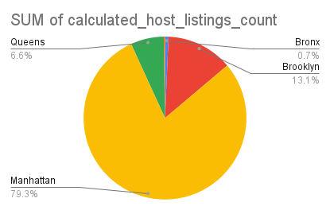
What are the total numbers of calculated host listing count in various neighbourhood group?
This has given us insight that there are more calculated host listing count in manhattan than other neighbourhood group.

Slide 6
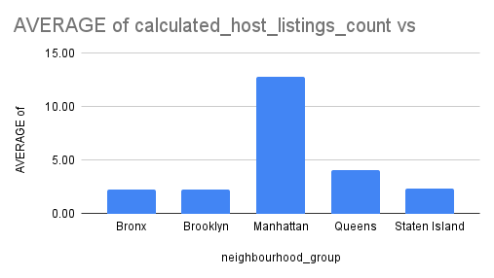
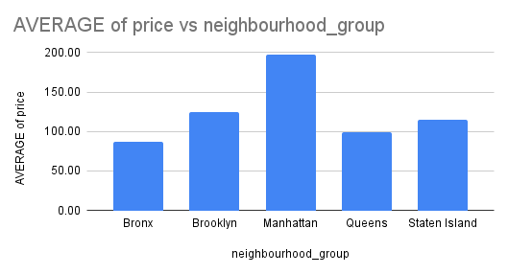
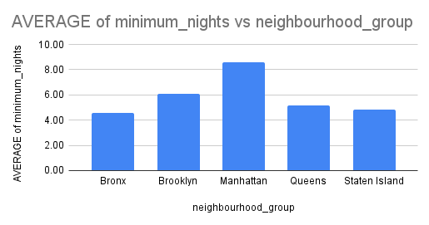
2. How does the average calculated host listing count/price/minimum night vary across different neighbourhood groups?
This has given us insight that manhattan has more calculated hosting listing count, higher price and more numbers for minimum a night across the different neighbourhood groups.

Slide 7
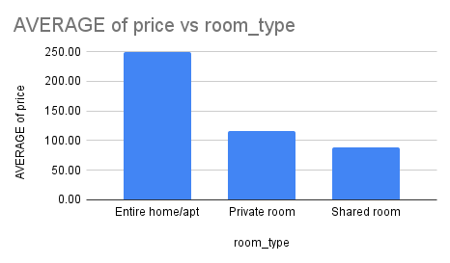
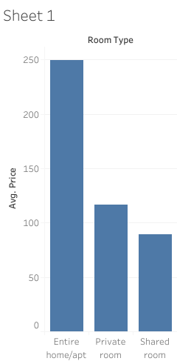
3. What is the average cost of Manhattan in different room types?
This shows that entire home/apt room type is the most expensive and the shared room type is the cheapest.

Slide 8
5. What are the 20 most popular room type?
id | neighbourhood_group | room_type | Calculated Host Listing Count
36487245 | Manhattan | Private room | 1
36485609 | Manhattan | Shared room | 6
36485431 | Manhattan | Entire home/apt | 1
36485057 | Brooklyn | Private room | 2
36484665 | Brooklyn | Private room | 2
36484363 | Queens | Private room | 2
36484087 | Manhattan | Private room | 1
36483152 | Brooklyn | Entire home/apt | 3
36483010 | Manhattan | Entire home/apt | 1
36482809 | Manhattan | Private room | 2
36482783 | Brooklyn | Private room | 1
36482416 | Manhattan | Private room | 2
36482231 | Brooklyn | Private room | 1
36481615 | Brooklyn | Private room | 1
36481315 | Brooklyn | Entire home/apt | 3
36480292 | Brooklyn | Entire home/apt | 1
36479723 | Queens | Private room | 5
36479230 | Brooklyn | Private room | 1
36478357 | Manhattan | Private room | 1
36478343 | Manhattan | Private room | 1

Slide 9
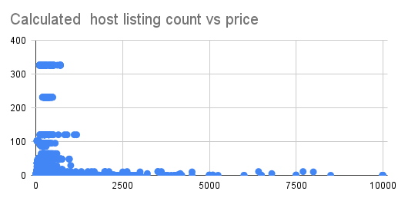
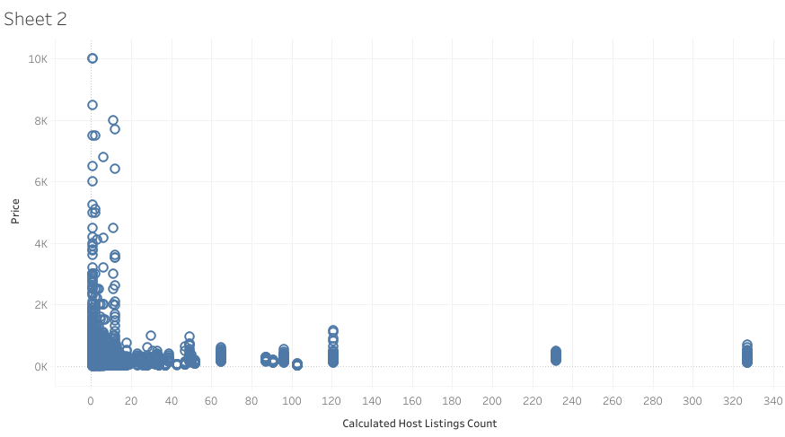
6. Does calculated host listing count impact the price of the room types?
Yes, the calculated host listing count does impact the price of the room type.

Slide 10
Summary:

Slide 11
Summary of findings:
Top 5 Neighbourhood group:
  Almost 68% of neighbourhood group come from Manhattan and the top 5 neighbourhood group are from Manhattan as well.
Entire Room/Apt and Shared Room Type:
  Entire room/apt and Private room both have high calculated host listing count (271834 vs 72062), but entire room/apt are more than 2x in calculated host listing count.
Neighbourhood Group Pricing:
  Manhattan is the most expensive followed by Brooklyn then Queens followed by Staten Island and the least being Bronx.

Slide 12
Actions & Recommendations:

Slide 13
Recommended actions:
Product recommendations:
Focus on getting more calculated host listing count in Bronx for neighbourhood groups.
Our data tells us that our Manhattan neighbourhood are most popular and people are willing to pay for it. Marketing and advertising campaigns should therefore market and advertise more shared room type in Manhattan.

Slide 14
Thank you!

